Slide 1

Increasing SATs participation Rates

Slide 2
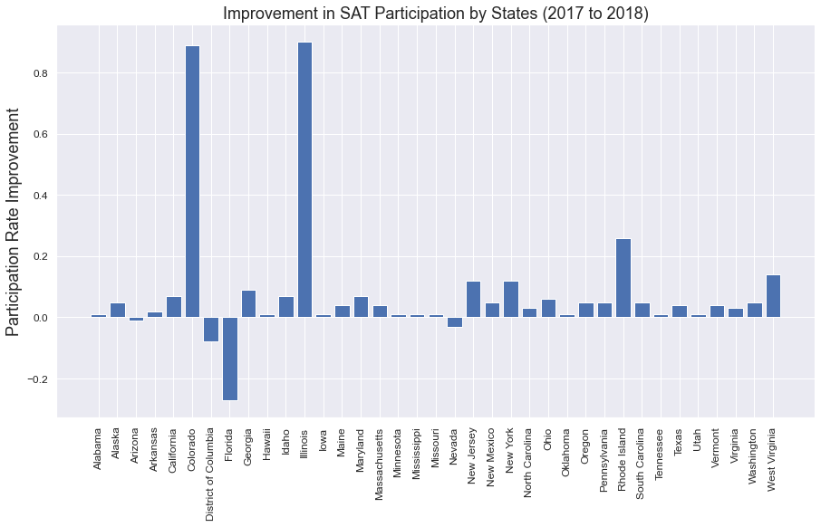
What factors contributes the most to the improvement of SAT participation rates?
The biggest contributions to SAT Participation rates between 2017 to 2018 is the conversion of Colorado and Illinois to SAT mandatory states
Other top contributors include:
Rhode Island
West Virginia
New York
New Jersey
Increasing SATs participation Rates

Slide 3
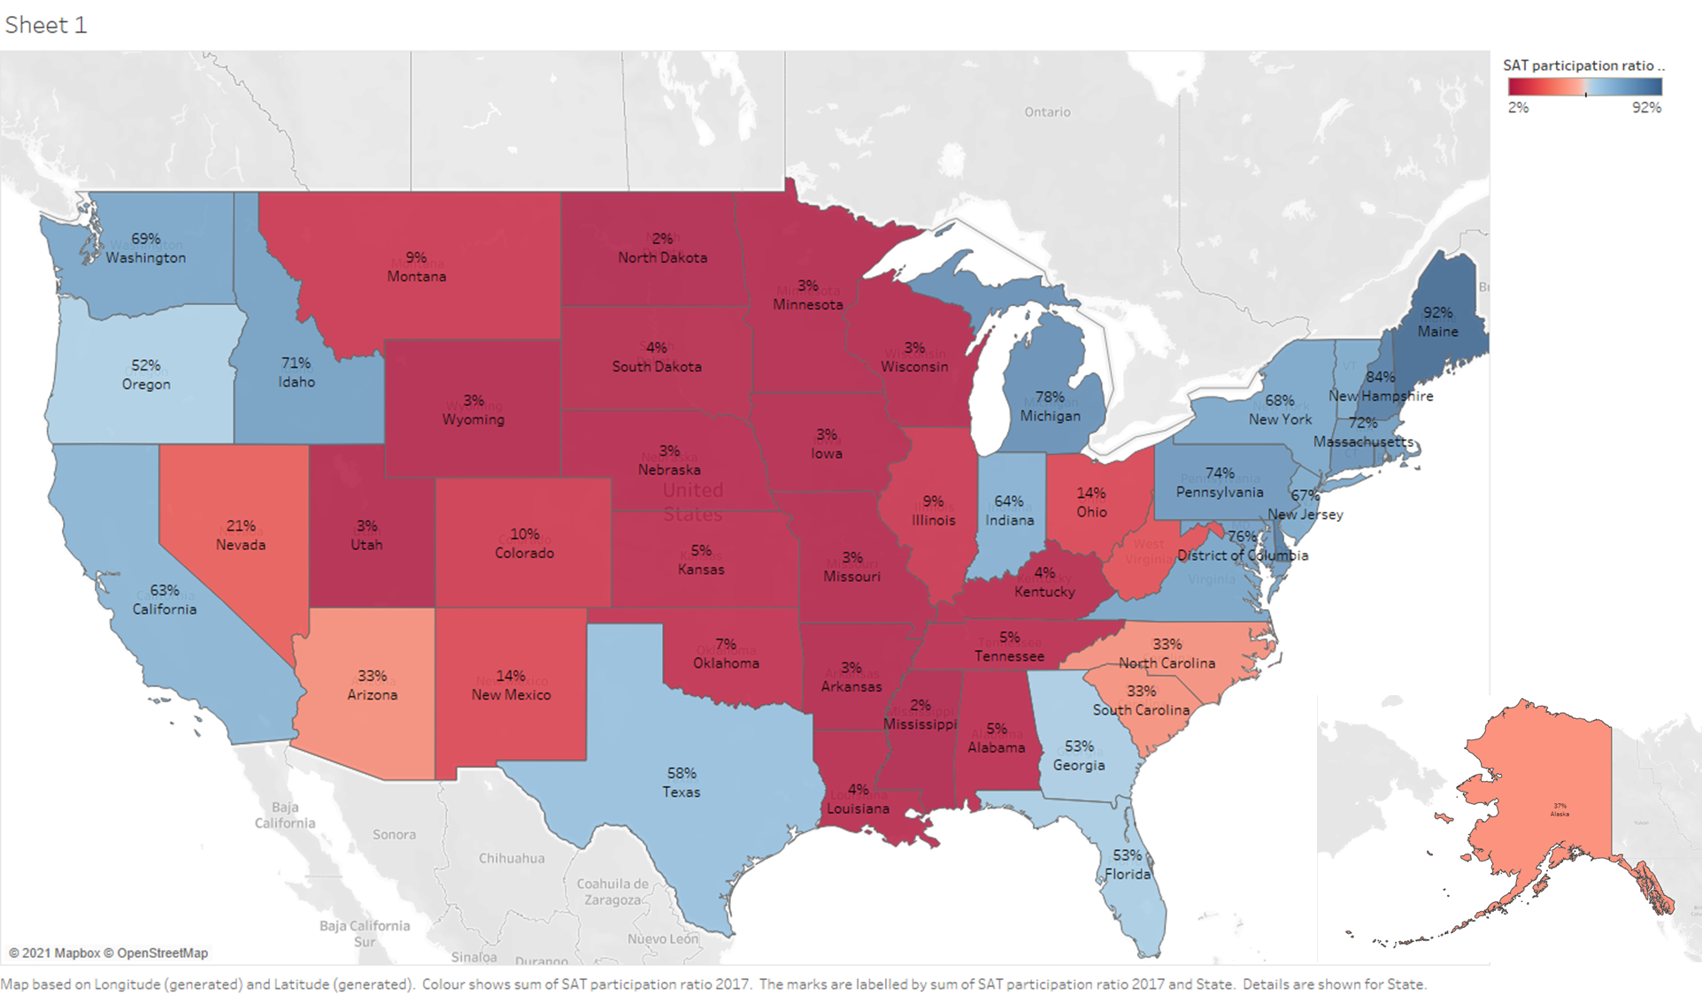
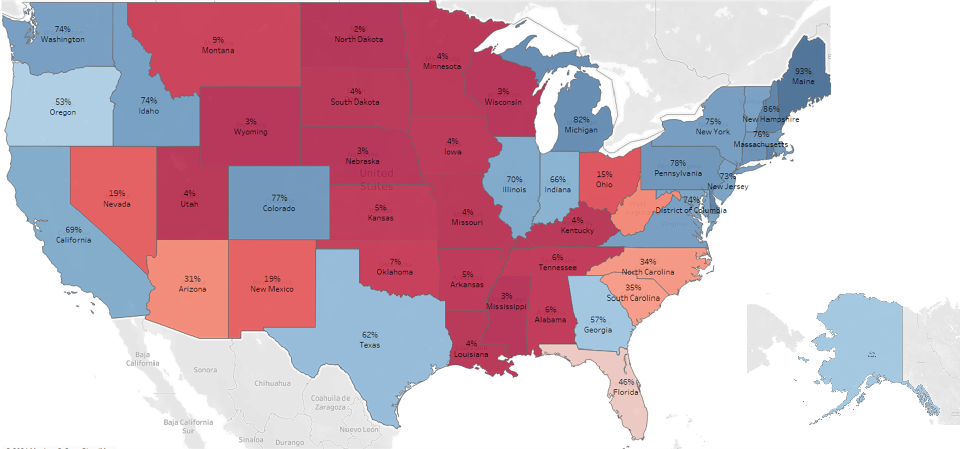
Shift in states favouring SATs to ACTs (2017 to 2018)
Increasing SATs participation Rates
Rhode Island
West Virginia

Slide 4
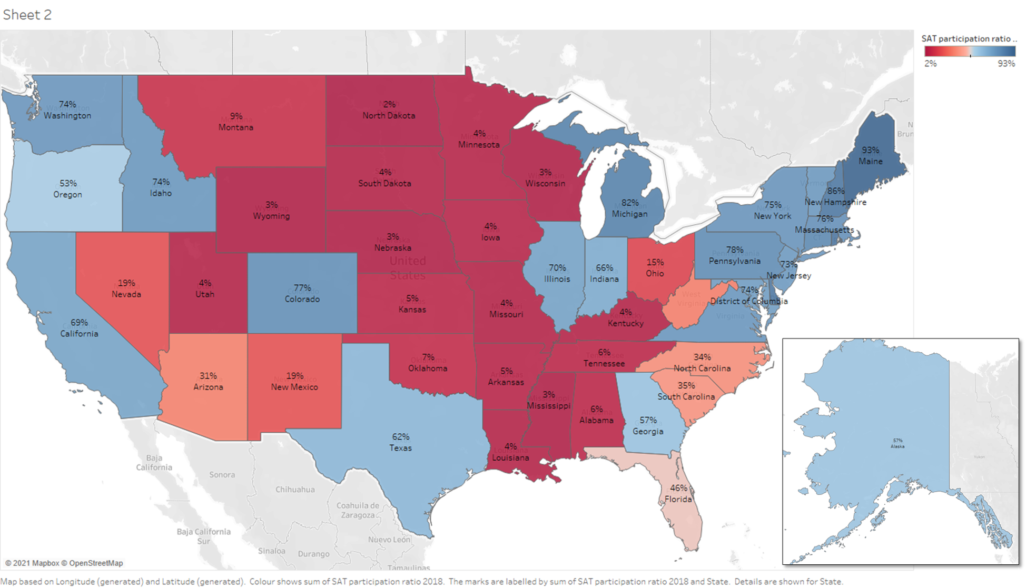
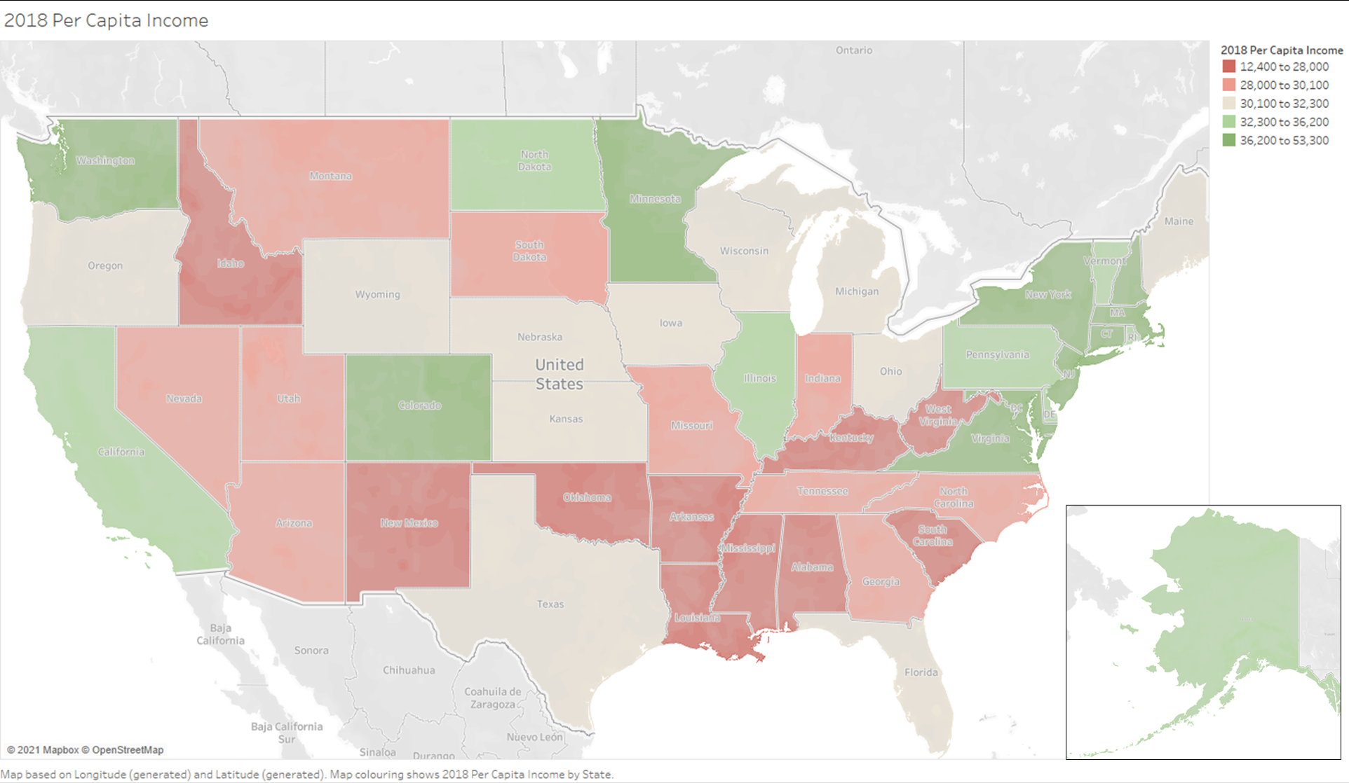
Finding 1:
States with a higher per capita income are more likely to adopt the SATs than ACTs
2018 SAT vs. ACT Participation Ratio
2018 Per Capita Income
4. New York
Increasing SATs participation Rates
1. Rhode Island
3. New Jersey
2. West Virginia

Slide 5
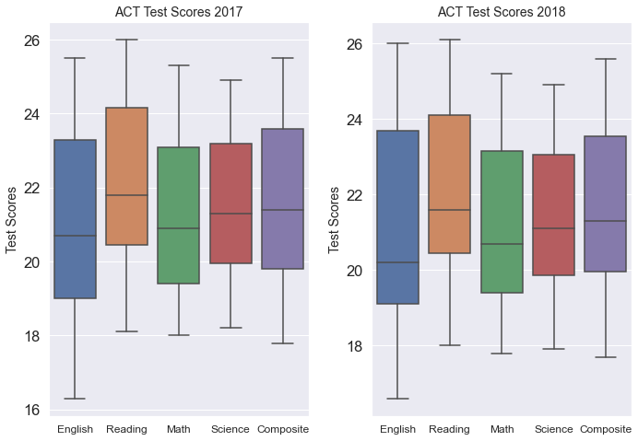
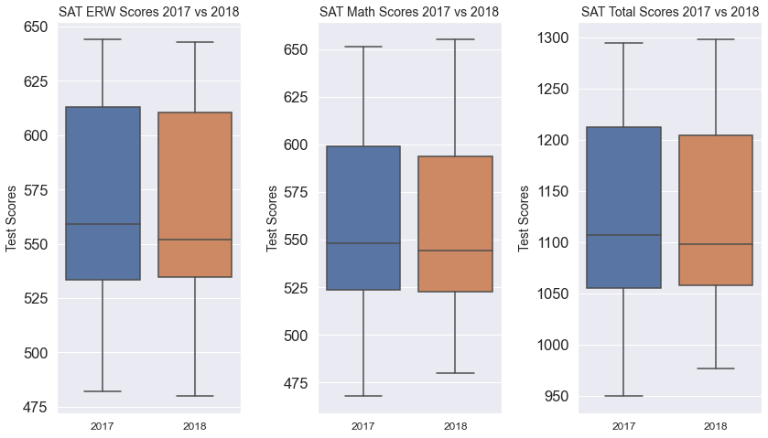
Finding 2:
Students who are stronger in languages (Reading/Writing) should take the SAT while students with strength in Maths or Science should take the ACT.
ACT Test Performance
SAT Test Performance
Increasing SATs participation Rates
Students taking the ACT do the worst in English subtests
Students taking SATs do better in Essay, Reading and writing than Maths subtests.

Slide 6
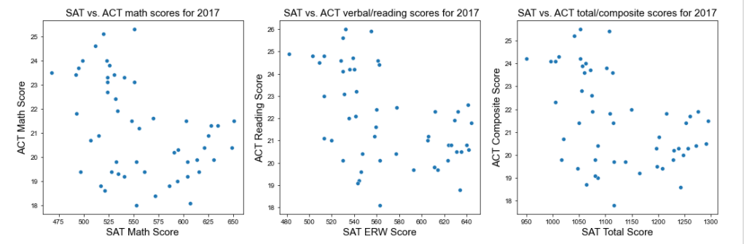
Finding 3: States that score well on the ACTs tend to score poorly on the SATs and vice versa
Increasing SATs participation Rates

Slide 7
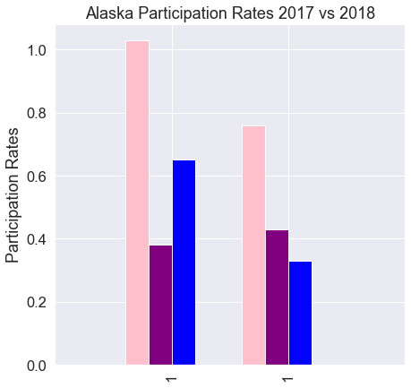
Alaska
Population: 731,545
Under 18: 25%
Status: Declining Population
Income: $36,978 Per Capita Income
2018 SAT Participation: 43%
Alaska total participation in college admission tests has dropped significantly between 2017 from 2018 (27% drop)
Despite that its SATs participants has increased by 5%. ACT has suffered a significant drop in student participation totalling 32%.
Increasing SATs participation Rates
Total
SAT
ACT
Total
SAT
ACT
https://www.macrotrends.net/states/west-virginia/population
https://censusreporter.org/profiles/04000US45-south-carolina/
2017
2018

Slide 8
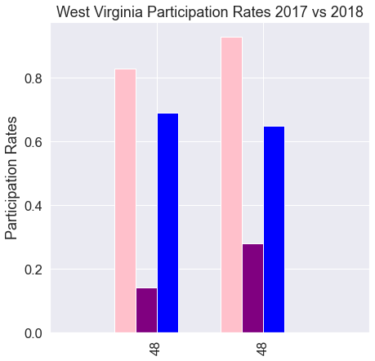
West Virginia
Population: 1,792,147
Under 18: 20%
Status: Declining Population
Income: $27,446 Per Capita Income
2018 SAT Participation: 28%
West Virginia has an increased number of total participation in college admission testing from 2017 to 2018
Its SAT participation rate has also doubled showing a growing trend in students taking the SATs compared to the ACT which has dropped by 5%.
Increasing SATs participation Rates
https://www.macrotrends.net/states/west-virginia/population
https://censusreporter.org/profiles/04000US45-south-carolina/
Total
SAT
ACT
Total
SAT
ACT
2017
2018

Slide 9
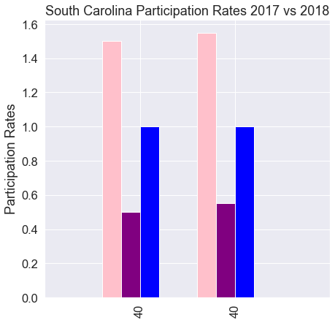
South Carolina
Population: 5,148,714
Under 18: 22%
Status: Growing Population
Income: $31,295 Per Capita Income
2018 SAT Participation: 55%
South Carolina is a state that mandates its high school students to take the ACTs. Yet, despite already having to take the ACT a large population of its students are taking both the SAT and ACTs (about 55%) .
On top of that, there is a growing number of students that are taking the SAT. There is an increase of 5% participation rate in the state between 2017 to 2018.
Increasing SATs participation Rates
Total
SAT
ACT
Total
SAT
ACT
2017
2018
https://www.macrotrends.net/states/west-virginia/population
https://censusreporter.org/profiles/04000US45-south-carolina/

Slide 10
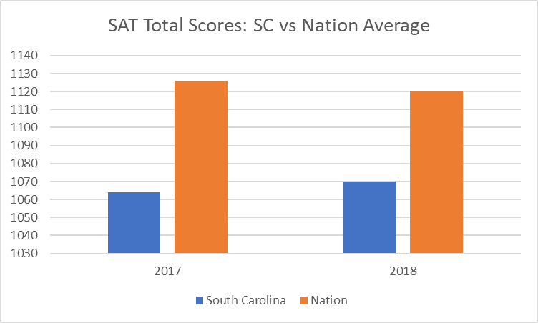
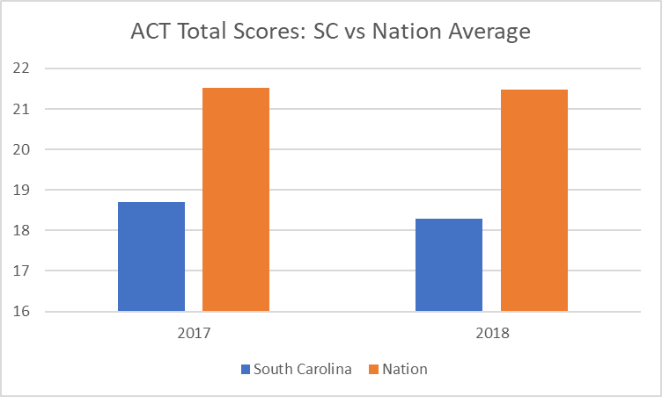
South Carolina students has fared relatively poorly in both tests year on year when compared to the nation average. This might be due to the large population of students taking both the SAT and ACTs.
Increasing SATs participation Rates
Hence, it is proposed that South Carolina change its mandate of ACT college admission testing to the SATs instead due to popular demand. With that students will not need to take 2 tests and just focus on one, allowing them to perform better on the SATs.
This proposal will help College Board to increase its participation rates in South Carolina by 45% if it succeeds.

Slide 11
Alaska
Population: 731,545
Under 18: 25%
Status: Declining Population
Income: $36,978 Per Capita Income
2018 SAT Participation: 43%
2019 Target Growth : 27%
West Virginia
Population: 1,792,147
Under 18: 20%
Status: Declining Population
Income: $27,446 Per Capita Income
2018 SAT Participation: 28%
2019 Target Growth : 22%
South Carolina
Population: 5,148,714
Under 18: 22%
Status: Growing Population
Income: $31,295 Per Capita Income
2018 SAT Participation: 55%
2019 Target Growth : 45%
Increasing SATs participation Rates
South Carolina is the most enticing market as it has the biggest population of people under 18.
It is a growing population
It has a fairly high income per capita
It is already implementing a state-wide college admission testing mandate and may consider to switch to SATs due to growing demand.

Slide 12
Thank You

